Slide 1


Name: Thomas Flynn
ID: 16117743
Course: Information & Network Security MEng
Supervisor: Dr. Sean McGrath
Project Title: Docker containers deployed using IBM Bluemix
Containerization platform
Docker Engine
Open source
Docker Hub
Platform as a service
Integrates Docker
Bare metal depoyment
Container lifecycle management

Slide 2
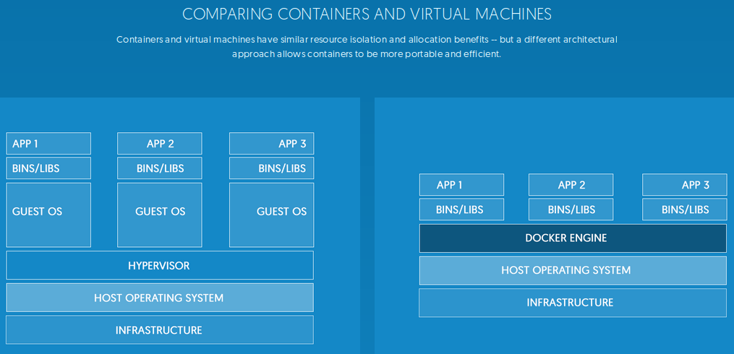

Virtual Machines
Separate set of resources
Heavyweight
Slow startup
Docker Containers
Shared set of resources
Lightweight
Highly scalable

Slide 3



Project Description
Build a bridge between WSN and data miners
using microservices and a scalable database
Primary Goals
CI/CD DevOps pipeline
Container orchestration
IoT simulation
Data commited to database
NoSQL graph database
Web application queries database
Secondary Goals
Load balance testing
Web application graph features
Test container network security
Test security of frontend – backend
Test security of backend – WSN

Slide 4









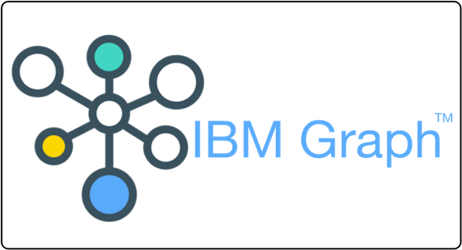


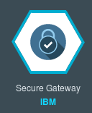




Chosen technologies
Documentation
IoT Simulation
Frontend - Backend
Database
DevOps & Security

Slide 5




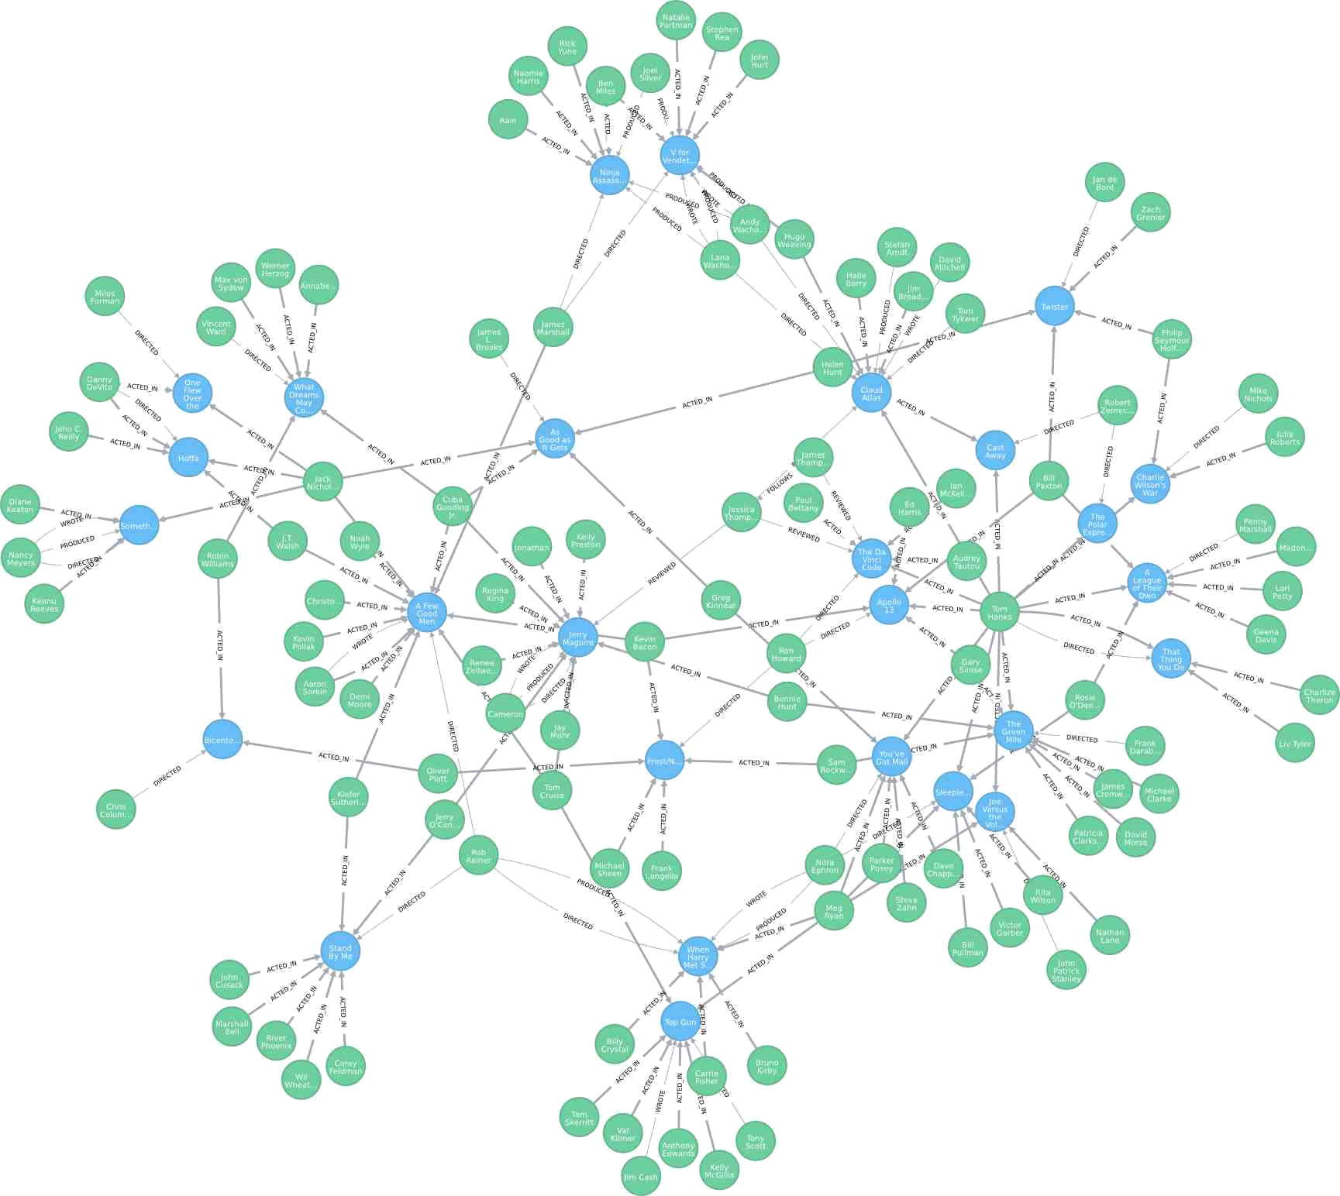
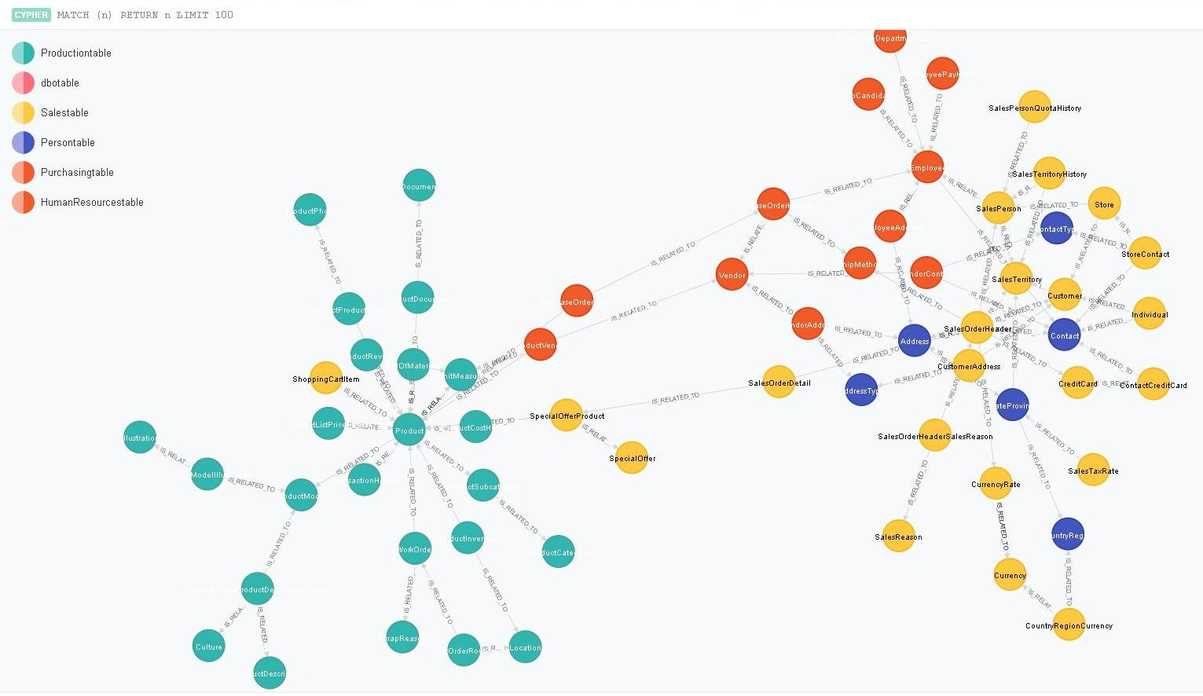
High level design
A2
A1
Description
Activity
B4
Simulate WSN data
A1
Store for a short period
A2
Commit to temporary database
A3
Commit to permanent database
A4
User queries WSN status
B1
Service queries database
B2
B2
Data retrieved
B3
Service transmits data
B4
B1
Data displayed to the user
B5
A3
B3
B5
A4
Temporary
database
Permanent
Database

Slide 6
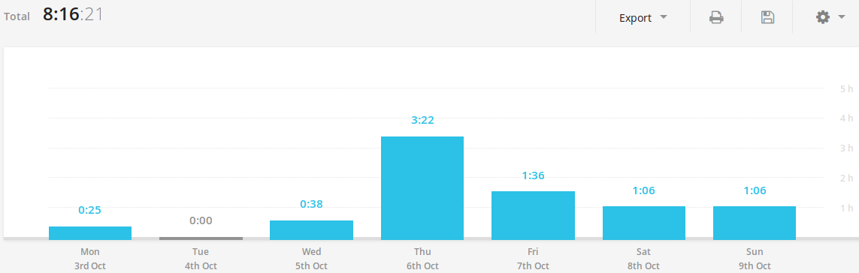
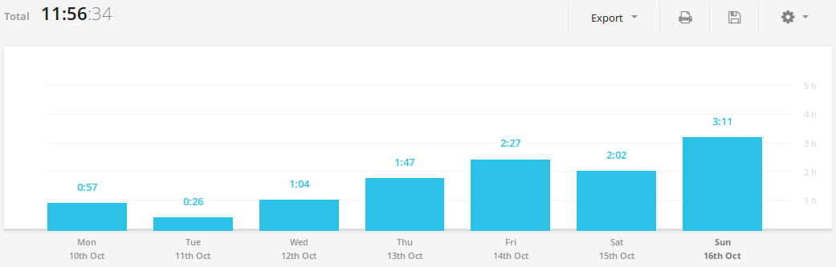
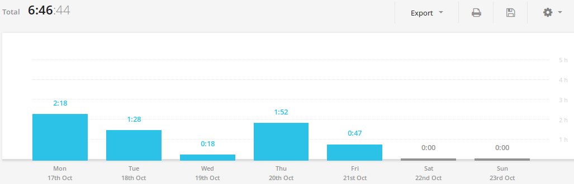
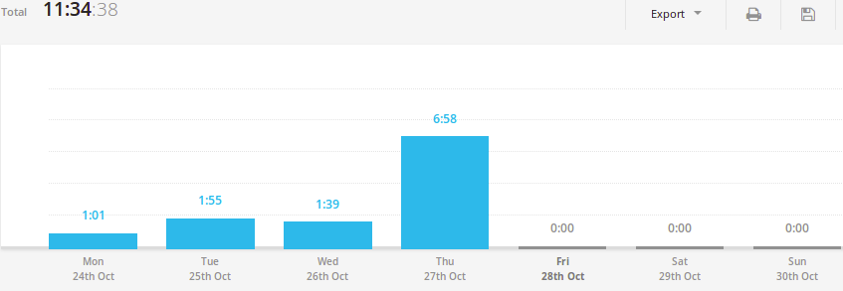
Progress to date
Week 5
Meet with supervisor
Create log template
Research Docker
Research Bluemix
Backup files
Install Ubuntu
Week 5 log
Week 6
Research Competitors
GitHub repositories
Install Docker
Start report
Research NoSQL
Research graph DB
Week 6 log
Week 7
Draw project plan
Spring Gantt chart
Summer Gantt chart
Two page summary
Draft report on Github
Week 7 log
Week 8
Bluemix account
IoT simulation
Install Bluemix CLI
Login to Bluemix (CLI)
Docker/Bluemix demo
Week 8 log

